Slide 1
The Gender Pilot – some comments
Gunnbjørg Naavik
The Norwegian Association of Local and Regional Authorities-KS
Budapest, 3 December 2015
Notes:
First of all, I would like to convey greetings from the five Norwegian politicians who participated in the pilot. They were all very sorry not to be able to participate, partly due to the fact that some of them changed positions after the Norwegian local elections in September, and partly due to the fact that December is a busy month, both summing up this year and planning for 2016.
I would like to sum-up very briefly the objective of the pilot,the activities and some experience expressed by the Norwegian participants

Slide 2
Overall Objective of the Project and the Pilot
Project (WP4)
Strengthening women’s role in public and political life
Support the balance between work and private life
Pilot
Exchange of experiences in the theme of work life balance
Notes:
Recapture the objectives of the WP as summed-up by Gabor Zongor.
NO partners and KS been supportive.
The actual work has been carried out in HU.

Slide 3
Expected Results from WP4 Gender Issues
Improved knowledge base
Experience from case studies - the pilots
Status on gender issues in the municipalities – the national survey
Establish dialogue between local and central government on gender issues
Further action
Notes:
Expected results were formulated by TOOSZ in February 2014 – when planning WP4. Gabor Zongor has summed-up hthe results. I will focus on the pilot.
Aim to have an improved knowledge base to develop and implement qualified actions :
Experience from case studies - the pilots part of this

Slide 4
Pilot Activities
Kick-off in Budapest April 2014
Hungarian colleagues to Norway in June 2014
Norwegian participants to Hungary in September 2014
Workshop in Oslo September 2015
Sum-up in Budapest December 2015
Notes:
KS contributed to development nad implementation of pilot.
Selecting and matching NO and Hu participants
Faciltate and coordinate NO activities
There has

Slide 5
Some Norwegian Experiences
Hectic – but exciting -programmes both in Norway and Hungary – as much as possible within the timeframe available
A couple of days extra would have been useful – shadowing each others’ daily life, both as politicians and family members
Cooperation with HU functioned well
Expectations fulfilled
Would be interested to cooperate further on issue - given the opportunity
Some specific results from the exchange
New knowledge-new friendships (also in NO)
More conscious about what we have achieved on gender equality in NO. Still have a lot to do.
Notes:
Very brief questions to the participants to get some feed-back in their experiences and impressions after participating in these activities.
As you know Gender Equality has been on the Norwegian political agenda for decades. Womens right to vote 1913. Ombud for Equal Status for men and women 1978.
The Gender equality act was introduced in 1979, and laid the foundation for much of the development within this field, which resulted in a framework focusing on facilitating what we could call work-life balance, making it possible to combine work and familiy life. Although political parties today may have different points of views depending on political colour with regard to how and what measures should be introduced to achieve a good balance between work and family life, Norway is a country with long traditions and a solid framework to facilitate this.
We have talked a lot about the Nordic Model in the project we have had together with TOOSZ on Decent Work and Tripartite cooperation. What characterisis the Nordic Model is a well developed welfare state, which includes a welfare scheme also to facilitate WLB – such as kindergartens that parents can afford, maternity leave, sick-leave arrangements (when children are sick), flexible working hours etc.
These are expensive measures/schemes.
The Nordic Model also faces challenges…….
When Norwegian pilot participants visit Hungarian colleagues they bring this reality with them. And a good portion of curiosity about life, people and politics in Hungary.
Some statements to illustrate this.

Slide 6
Statement
«New focus on my own behalf on gender related issue. Especially regarding the importance of the national policies, legal framework and practical solutions. Equality and gender issues is not something we can count on beeing solved once and for all. If we seriously think that all human beeings – independent of gender – should have the same possibilities and rights in using our abilities, following our interests for education and work, society must have focus on measures to facilitate this.»
Notes:
I will conclude with two statements from the participants which I think reflects some of their thoughts.

Slide 7
Statement
«I have gained knowledge about Hungarian challenges as a relatively new democracy, and a local democratic system functioning differently from in Norway. I have seen large cultural differences when it comes to gender equality, and met strong and skilled women beeing in front wishing to influence their society. I have seen the beautiful Hungarian country, the countryside, small villages and fantastic Budapest. Rich in culture and kind and polite people.»

Slide 8
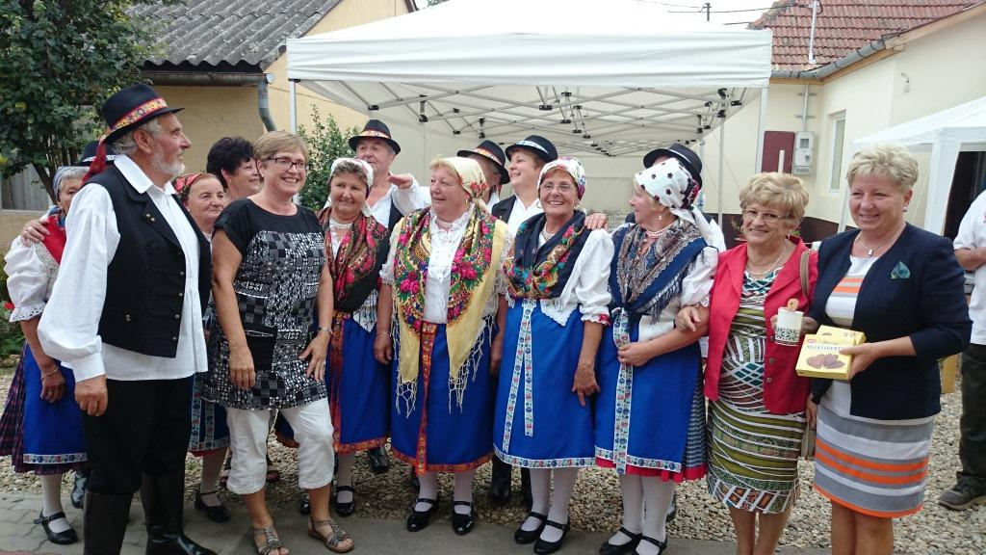
Thank you for your attention !
Thank you for your attention !
Notes:
I look forward to listen to results and experiences from the five Hungarian porticipants in the pilot.
Thank you for your attention.

