Slide 1
Nittedal municipality
Mayor
Hilde Nysten Thorkildsen

Slide 2
Urban and rural
23.000 inhabitants
91% farmland and forest
186 km² (≈ 40 % av Oslo)
Population density: 107 persons/km² (≈ Aserbajdsjan ☺)
Budget: 1,3 billion NOK

Slide 3
Rotnes – a future city

Slide 4
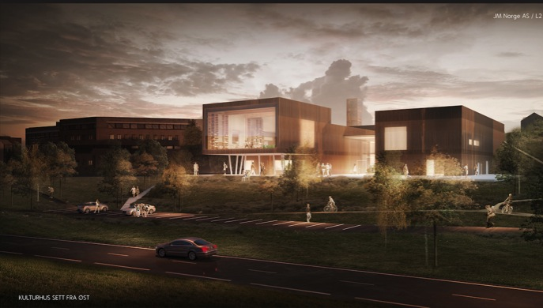
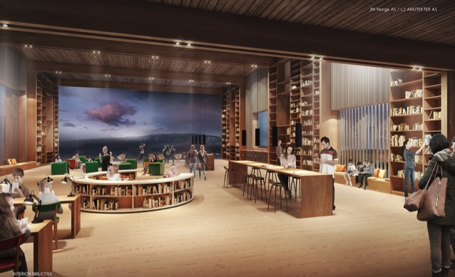
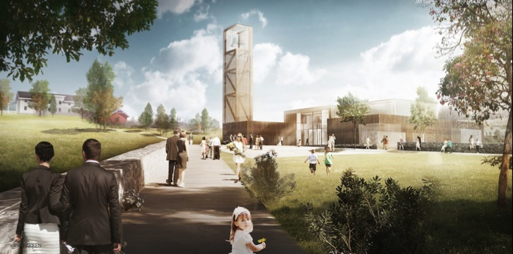
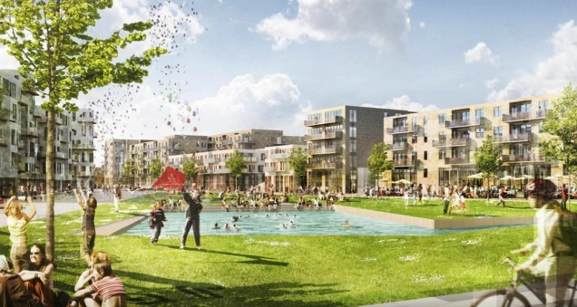
Cultural centre, church and a new city centre

Slide 5
Gender distribution in Nittedal
Full time equivalents: 875
Total number of employees | 1086 | Total number of leading positions | 28
Women | 901 | Women | 20
Men | 185 | Men | 8
% women | 83 | % women | 71
% men | 17 | % men | 29

Slide 6
Measures to reach gender equality
We want more men to work in our services – schools, health care, kindergardens, etc.
Higher pay is not used to attract more men – pay level is based on qualifications only
Gender is in general not an issue when recruiting

Slide 7
Employment policies
The council has adopted an employment policy
The policy describes the overall goals and strategies to increase competence, motivation and well-being of our employees
Competent and motiovated employees is one of eight main goals for the municipality

Slide 8
Gender distribution – political committees
The law requires at least 40 percent
Council: 14 women – 15 men
Committee for health and care: 6 women – 5 men
Committee for culture and education: 5 women – 6 men
Committee for environment and development: 6 women – 5 men

Slide 9
Gender distribution in boards of intermunicipal cooperations
8 intermunicipal cooperations – 13 members in the boards from Nittedal
7 members are women – 6 members are men
In general we will always try to have at least 40 percent woman representation altogether in boards and committees

Slide 10
Thank you for your attention
Notes:
– Først hva vi ser
– Så hva vi vil gjøre

