Slide 1
How can municipalities work on different aspects of equality and diversity?
Liss Schanke
Budapest December 2015
Norwegian Association of Local and Regional Authorities

Slide 2
Monotoring and measuring at municipal level
Municipal gender equality index
Mainstreamed: collected and analysed annually by National Statistical Bureau
Covers 16 key indicators relevant to gender equality
Covers all municipalties and provinces
Enables them to compare their results with the national average, with their neighbours – as well as see their own development over time.
Basis for administrative planning of gender equality initiatives
Basis for political decisions across party lines

Slide 3
Gender equality indicators
Percentage men 20-66 working part time
Percentage women 20-66 working part time
Percentage fathers taking full fathers’ quota or more
Percentage women municipal council members
Percentage women employees age 20-66 in the public sector
Percentage women employees age 20-66 in the private sctor
Percentage women among leaders age 20-66
Level of gender balanced business structure
Level of gender balance in educational programs in upper secondary school

Slide 4
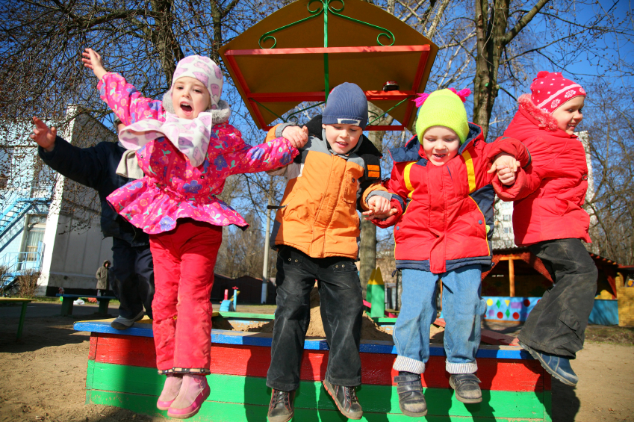
Kindergarten indicator
Indicators
Percentage 1-5 years in kindergartens
Kindergartens are seen as important to childrens’s development and future learning, especially children from poor or immigrant families – apart from being important for working parents

Slide 5
Social security indicators
Indicators
Percentage men with higher education
Percentage women with higher education
Percentage men 20-66 in the work force
Percentage women 20-66 in the work force
(measure employment rate, not unemployment rate)
Average gross income for men
Average gross income for women

Slide 6
Three municipalities
Gran: 14.000
Small rural municipality: Focus on kindergartens and other services for children to keep and attract young people
Sagene/Oslo: 40.000/600.000
Multicultural district in the capital Oslo: Focus on social inclusion and employment
Kristiansand: 87.000
Conservative region: Focus on broad gender equality strategies

Slide 7
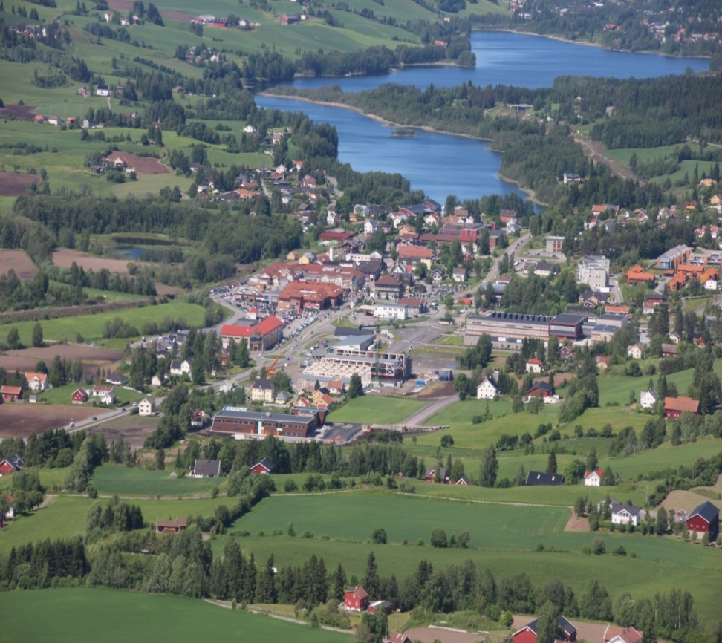
Gran muncipality
Rural municipality, 60 km. north of Oslo
14.000 inhabitants
Long traditions in agriculture and forestry
6% of the population engaged in farming, 16% in industry/construction, 78% in commerce and services
2000 persons, work outside Gran, half of them in Oslo, the rest in neighbour communities.

Slide 8
Gran: Key challenges
General challenge – typical for small rural municipalities
Elderly population – as many small rural municipalities.
Not sustainable with regard to demography/economy
Lower educational level than in Oslo and Kristiansand
Specific challenges
Gran needs to keep and attract young people as a basis for a sustainable economy and labour market
Young people want children, kindergartens, schools, other public services, facilities for culture/sports + flexible working hours
Advantage 1: price of house + garden= tiny apartment in Oslo
Advantage 2: 60 km. from Oslo, can commute + work from home

Slide 9
Gran: Initiatives
Gran ensures kindergarten 1-6 years for all children
Gran has 16 kindergartens, 9 private and 7 public
Private kindergartens have public support and are supervised by the municipality.
All schools have activities before and after school for pupils 6-10 years, 07.00-16.30
After school services are good, but too expensive
Full time, i.e. 27 hours a week, costs 377 Euro a month.
Few parents want full time, many buy extra hours when they need it. Only pay for the number of hours they need.

Slide 10
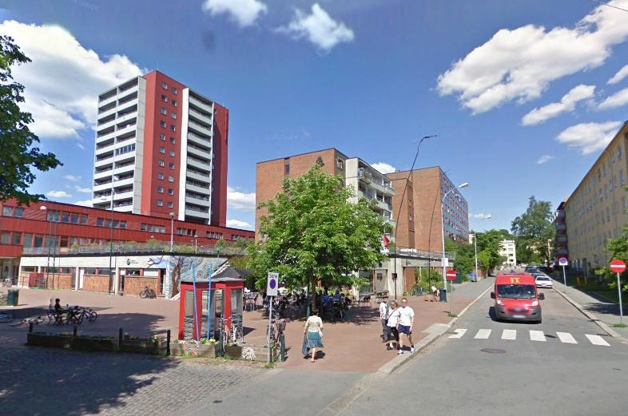
Sagene district in Oslo
Oslo, the capital of Norway, 600.000 inhabitants
One of the 15 districts in Oslo, 40.000 inhabitants
Separate administration and political council.
Mixed population: middle class + people living in the 2.400 public apartments, i.e. persons who cannot afford to buy/rent open market apartments: e.g. immigrants, refugees, people with health/drug problems.

Slide 11
Sagene: Key challenges
25% immigrants, mainly non-western.Largest group is Somalia, then Morocco, Algeria, Iran, Iraq, Pakistan.
Somalians came as political or humanitarian refugees after 2000, many illiterate, most with low educational level, depend on public housing and services
High persistent relative poverty rate for families with children, i.e. poverty lasting more than 3 years, but low absolute poverty according to international rates.
Relative and absolute poverty in Norway is closely linked to unemployment, around 3-4% for adults, 7% for young people.
Unemployment rate higher for first and second generation of immigrants, employment rate lower, especially for women.
Large percentage of young immigrants drop out of secondary school – especially boys

Slide 12
Sagene: Initiatives
Keeping the middle class happy and make them want to live in the district:
  high quality services, cultural/interesting community, volunteer activities
Inclusion/participation against marginalization/family poverty
  Young people: activation, education, employment
  Adults: activation, capacity building, language classes, employment
  Children: Kindergartens and after school services
  All: Community development in the public housing areas.

Slide 13
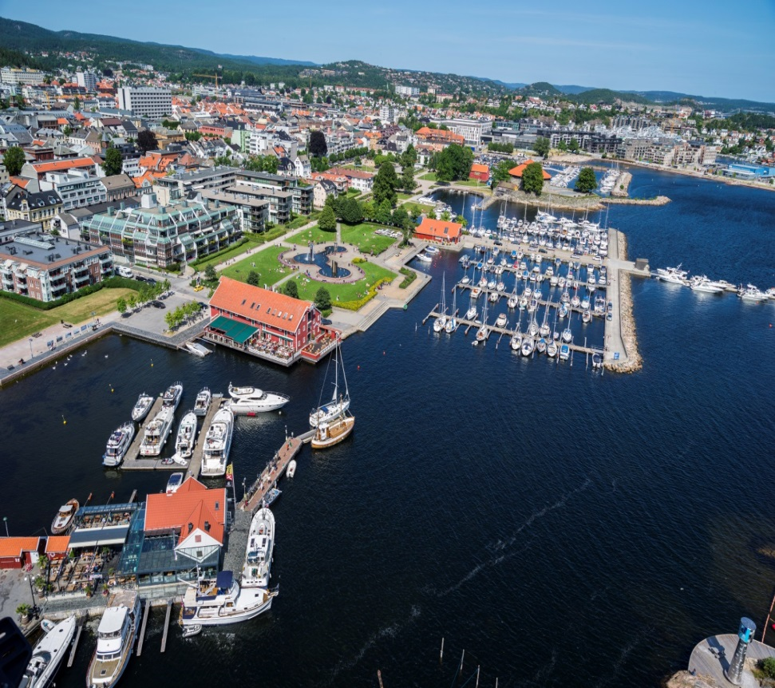
Kristiansand municipality
Biggest city in Southern Norway
Administrative, business and university centre
87 000 inhabitants
Large number of companies related to the oil industry
Recently affected by decline in oil sector prices and jobs

Slide 14
Kristiansand: Key challenges
Overall challenges: conservative region with traditional religious values
Kristiansand: Least equal of 5 biggest N. cities, but the most equal in the Agder region, the region in the south of Norway
Specific challenges
38% of women work part-time. Some voluntarily, some not
Many women do not have paid work at all.
Women/men have lower educational level than other cities.
Education/labour life more gender divided than other cities: Men: management and technical professions in private sector, women: care and education in public sector.

Slide 15
Kristiansand: Initiatives
Elaboration of a municipal strategy for equality, inclusion and diversity 2015-2022
Issues:
  Gender mainstreaming - equality is every leader’s responsibility
  Developing a full time culture – benefits staff as well as users
  Include a focus on LGBT
Participating in the regional strategy for equality, inclusion and diversity 2015-2027
Issues
  Made according to most demanding legislation, “Planning and Building Act”, implies 2 years of planning, elaboration and broad consultations

Slide 16
Some experiences
Gender Equality takes time
Gender Equality pays
Mainstreamed, i.e. integrated into permanent policies, activities, institutions, staff and budgets - not ad hoc projects
Simple non-academic language
Gender regards both men and women
Statistics can be a powerful tool

