Slide 1
KOSTRA - Local government State Reporting
Sigmund Engdal
Special adviser
Notes:
KOSTRA –abbreviation of Local government (Municipality) State Reporting in Norwegian

Slide 2
Overview of presentation
The aim of KOSTRA
Legislation and provision of the Local Government act
Use of information
KOSTRA gives a lot of possibilities –examples

Slide 3
Aims for KOSTRA (1)
Provide local authorities and Government with
    current
    relevant
    reliable
    and
    comparable
management information
on local finance and services

Slide 4
Aim for KOSTRA (2) – provide current information
Coordinate the reporting routines
Improve the efficiency and management of the reporting routines
Use the latest and most suitable technologies

Slide 5
KOSTRA – a useful tool for
Central government
Local and regional governments
(municipal and county authorities)
  Administration and control
  Budgeting
  Distribution of money
-----------------
Scientists
Students
Media
Unions
Organizations
Notes:
In addition to the governments itself:
Students and researchers often want to compare and analyze long time series of data.
Media is interested in how governments are spending taxpayers money, the same applies to various unions, organizations etc. who want to influence the political agenda.

Slide 6
The chain of reporting before KOSTRA
Municipal/ County department
Municipality/ County
Regional state
Ministries
Statistics Norway

Slide 7
KOSTRA’s chain of reporting
Municipal agency
Regional state
Statistics Norway
Municipality
Ministry

Slide 8
Common accounting rules – success factor
Municipality accounting – have to take into account both internal and external needs
  accounting string and flexible financial IT systems
KOSTRA Classification by Function, example:
  201 Kindergartens
  211 Extra care for children in kindergartens
  221 Localities and transport for children in kindergartens
Classification by Types of Expenditure, ex:
  100..290 Expenses for services produced by the municipalities, ex, energy, teaching materials, maintenance, consultants etc. (purchase of services entered into own services)
  370 Services bought from others (private companies, other municipalities or the state – replaces own services)
  470 Transfers
  010 Wages permanent employees
Notes:
A little about the accounting regulations:
To be able to compare the key figures from one municipality to another we need standard classifications of the accounts.
The accounting system are dived in to different municipality services for example:
201 Kindergartens
211 Extra care for children in kindergartens
221 Localities and transport for children in kindergartens
Further the account is classified into different types of expenditure and revenues. Like type 010 wages.
By combining function and type we may say how much money each municipality spends on wages in kindergartens. And so on..

Slide 9
KOSTRA – Reporting system
Resources
Man- labour year
Expenditures and revenues
Productivity
Public services
Recipients
Extent and frequency
Priority
Coverage ratios
User group
Population
Population characteristics
Notes:
This figure shows how we combine different types of information in the KOSTRA system to publish key figures for productivity, priority and coverage.
To publish this information we need data on:
Resource allocation – for example accounting data and personnel data
Data on services and users
Requirements – populations (for example data on children in the age 0..5)
This is meant to give central and local government necessary information to govern.
The information is also needed by the municipalities for planning and development purposes. The municipality can study the statistic over time and comparison them selves whit other municipalities.

Slide 10
Legislation and provision
The national KOSTRA system was introduced 01 January 2001
This was done by revision of the Local Government Act
The reform included legislation of the duty of reporting

Slide 11
The Local Government Act
Section 49 :
“Municipalities and county municipalities are required to currently supply the Central Government with information about economic spending and public services for use in national information systems”.

Slide 12
Provision of the Local Government Act (1)
Section 1 - This provision concerns the supply from municipalities and county municipalities of current information on finance and services for use in national information systems and in national statistics.
Section 2 - The achieved information is to be basis for planning and management both for central and local government. And basis for valuation of achievement of national aims.

Slide 13
Provision of the Local Government Act (2)
Section 6 - Municipalities and county municipalities are required to systematically register and store information concerning inputs and services.
The information must be stored electronically.

Slide 14
Making the information useful
Standardized reporting - better quality
Comparability- compare services – benchmarking
A better tool for planning
Focus and challenge for the future is to exploit the favorable situation and the possibilities that KOSTRA gives

Slide 15
Divisions of services (municipalities)
A. Profile of needs B. Finances
(population, divorced, single parents, unemployed, etc.) (financial key figures, purchase of services, charges, etc…)
---------------------------------------------------------
C. Kindergartens J. Nature and environment
D. Education K. Culture
E. Healthcare L. Church
F. Nursing and elderly care M. Transportation
G. Social services N. Housing
H. Child welfare O. Arrangement for trade
and business services
I. Water, sewage, disposal
and refuse collection P. Fire and accident
R. Agriculture S. Employment

Slide 16
KOSTRA reporting and publishing
15.1. Reporting of file extracts for client data and kindergartens from municipalities (year n-1)
15.2. Reporting of other data from the municipalities (year n-1)
15.3. Publishing of data (not revised figures) (year n-1)
15.4. Reporting of corrected data from municipalities (year n-1)
15.6. Publishing of revised data (year n-1)
Notes:
KOSTRA- calendar
Within 15. January the municipalities report the past years file extracts for client data and kindergartens.
Within a month later the municipalities report the accounting data and data fore the other services.
15. March Statistic Norway publish un revised figures for last year.
The next month the municipalities have the opportunity to control their data and report corrected data if necessary.
On June 15. we publish the reviseds date.

Slide 17
Example of use
Discussion of development and status in municipalities annual reports
Comparing with other municipalities – analysis/benchmarking of specific areas
Strategic planning and annual budgeting – development of targets

Slide 18
From a municipality’s annual report
Viewing trends in key figures

Slide 19
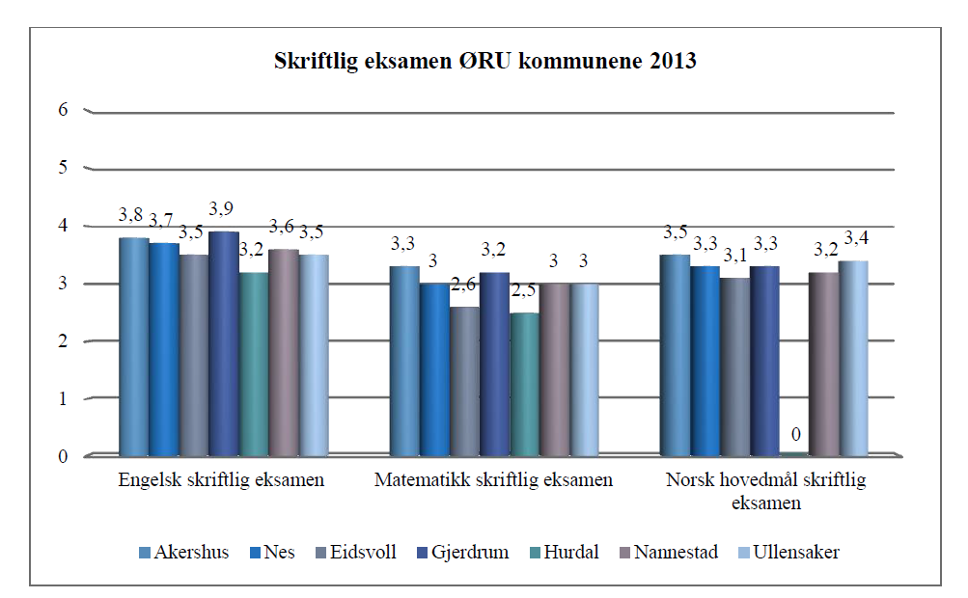
From a municipality’s annual report
Comparison with other municipalities – here written exam results - lower secondary school

Slide 20
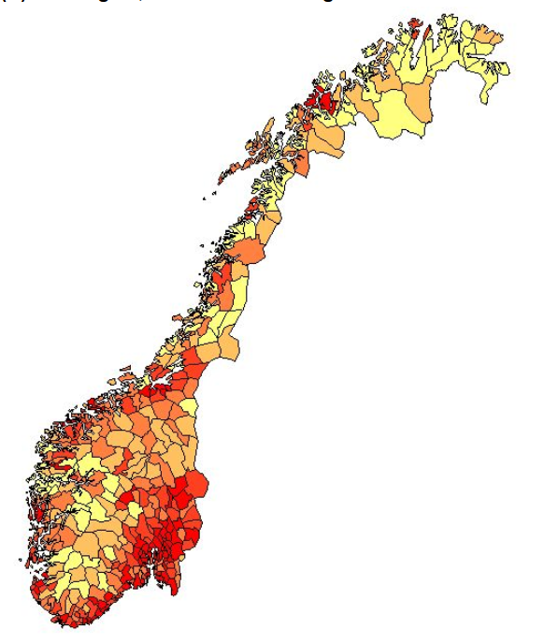
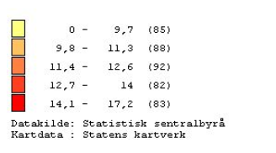
Average number of pupils in each class
Primary and lower secondary school (2013)
Notes:
Primary school and lower secondary school

Slide 21
Net expenses in primary and lower secondary school per capita 6 – 15 years

Slide 22
Net expenses in primary and lower secondary school per capita 6 – 15 years - Bergen

Slide 23
Statistics Norway
Municipality-State-Reporting
KOSTRA - Key figures on municipal activities http://ssb.no/en/offentlig-sektor/kostra

Slide 24
Extra

Slide 25
KOSTRA gives a lot of possibilities – an example from an ongoing development work in KS
Notes:
It’s the same framework for the county’s, but this will not be mentioned in this presentation

Slide 26
Connecting information from KOSTRA and the equalization of expenditure mechanism of the Grant Scheme for municipalities
The equalization of expenditure mechanism means redistribution of the income between municipalities:
  Each municipality’s or county’s production costs are calculated on basis of objective criteria.
  Each criteria is weighted on the basis of analysis indicating significant and systematic differences in involuntary production costs between municipalities
  Equalization of expenditure costs when there are systematic differences in production costs between different municipalities
Notes:
It’s the same framework for the county’s, but this will not be mentioned in this presentation
The municipalities in Norway have three main sources of income:
a) tax revenues,
b) transfers from the state
c) income from charges (including user payment)
The transfers are partly general and partly earmarked for special purposes. Tax revenues are largely income tax from persons. The municipalities are also able to collect tax on property and some municipalities have considerable financial and owner income from power stations. Tax revenues and general grant are unrestricted income and represent about ¾ of the municipal sector’s total income.
There are large differences between municipalities and between county authorities in both the level of income and in the level of expenditure needed. It is a national aim to offer citizens a high level of public services in all parts of the country. Therefore there is a high degree of redistribution of income between municipalities and between county authorities. This is achieved through the General Purpose Grant Scheme. Redistribution of resources through the General Purpose Grant Scheme ensures both a fair distribution of income, and regional growth and development. This is essential to maintain an efficient and autonomous local government sector.
BUT EVEN THERE ARE A QUITE A ESSENTIAL REDISTRIBUTION OF INCOM IN THE GRANT SCHEME FOR MUNICIPALITIES – THERE ARE STILL NOT INSIGNIFICANT DIFFERENCES IN INCOME BETWEEN THE MUNICIPALITIES.
But for today I’m not going any further on that. I’ll instead focus on the possibilities that are in connecting information from KOSTRA with the equalization of expenditure mechanism of the Grant Scheme. What are so this equalization of expenditure mechanism in the Grant Scheme for municipalities

Slide 27
Connecting information from the equalization of expenditure mechanism of the Grant Scheme for municipalities and KOSTRA
KS has done this for several years for the 10 biggest municipalities – annual reports
Working with development of a model that can be used by all municipalities, that:
  Visualize the spending and priorities made by the municipal council – taken into account the municipality's level of involuntary production costs and income level
The model is still not finished – but ready enough to be used in an example – (Utility for the municipalities in the ongoing Government initiated municipal merge process in Norway)

