Slide 1
Local Government Reform in Norway
2014-2017/2020
Executive Director Kjell-Torgeir Skjetne

Slide 2
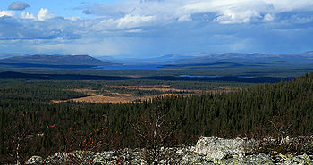
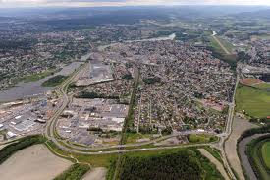
Two different challenges?
Rural municipalities: large areas, small populations
City regions: large populations, small areas
Notes:
Engerdal: 1390 citizens, 2150 sq. km

Slide 3
The reform process

Slide 4
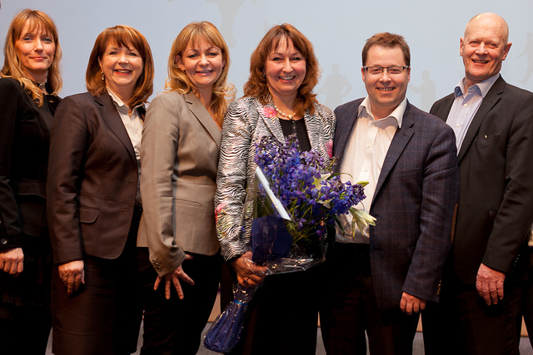
“Municipal boundaries can be changes with good local processes”
Arguments for:
More robust professional communities
Better co-ordinated land-use and transport planning
Reduced need for intermunicipal co-operation on central welfare issues
Warning against:
Exaggerating potential benefits
Belittling problems by using coercion
Statement from KS’ National Congress 2012

Slide 5
Expectations of the state from KS’ National Congress, February 2012:
That a rigid municipality model is not created – respect geography and settlement patterns
Respect local and regional ownership of processes as a prerequisite for the rapid realisation of benefits
Let the structure be determined by the tasks that are to be fulfilled
Consider stronger financial support for municipal merger processes

Slide 6
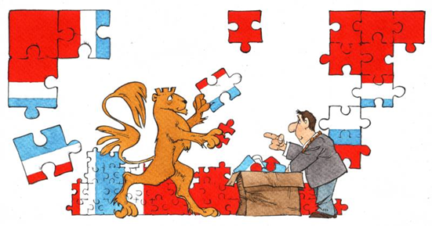
Anchoring in the members organisation
With a change in local government structure – what framework agreements should the local government sector expect/require from the state?
With a change in local government structure – how can provisions be made for good processes nationally and locally?
Are there particular circumstances in your counties that should be attended to, and how can this be done?
What should KS do going forward?

Slide 7
Clarify KS’ role
All of the nation’s municipalities are members of KS. There are differing opinions regarding the question of local government structure among the members, and therefore not appropriate for KS to take a clear standpoint for or against any particular solution.

Slide 8
Expectations of parliament
Any future reform decision in parliament must be built on a broad and stable majority
It must start with a clear definition of which tasks the local and regional levels should fulfil in the future
It must be developed in close collaboration with the local government sector, build on local processes and lead to increased municipal freedom
More flexibility and less state micromanagement as part of a such reform can lead to increased support for the local
It must consider decentralisation of tasks from central or state-regional authorities to larger elected regions

Slide 9
Local processes – the municipalities must be in charge
Processes within the framework decided by parliament, shaped by the municipalities locally
County Governors are guides – the municipalities will have the controlling influence on the process itself, KS advises

Slide 10
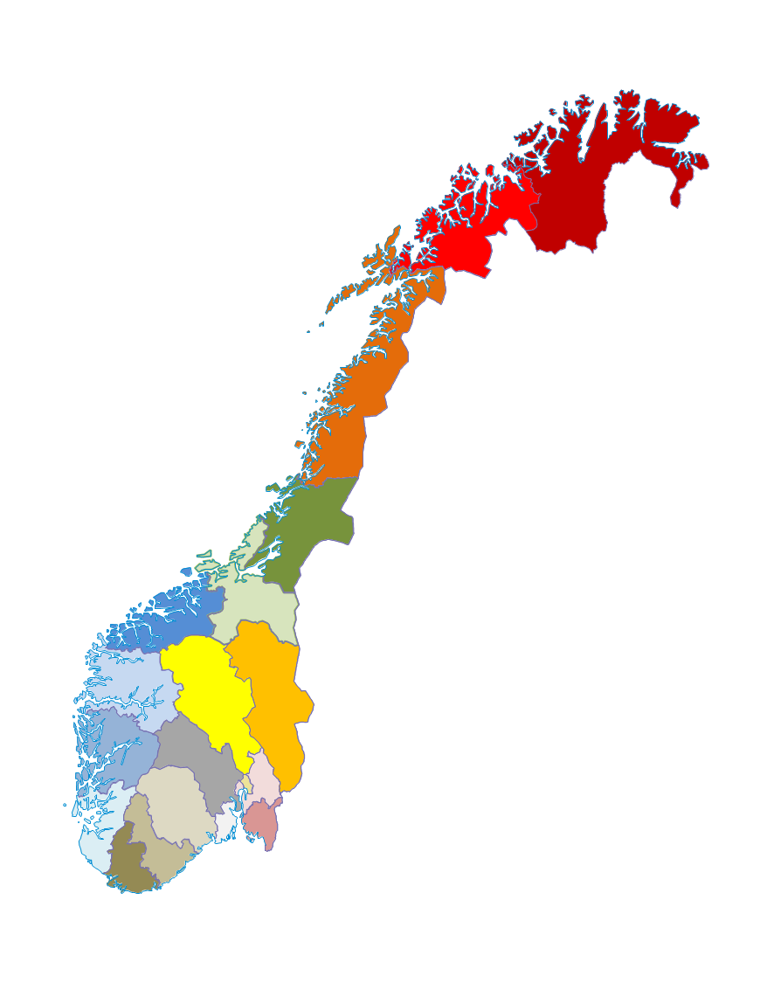
Secure an elected regional level of government
Establish that both local and regional elected levels of government will form the basis for further work with local government reform
Request that the government considers the transfer of tasks to the counties OR to a larger elected regional level as part of its review of tasks

Slide 11
Just a local government reform? What about a state and management reform?
The state must contribute by:
A significant reduction in state micromanagement and reporting requirements
A clear reduction in nationwide inspections
Fewer objections to land-use plans
Moving resources and tasks from the state to the municipality
More uniform regional organisation on the state side

Slide 12
THE FINANCIAL POLICY INSTRUMENTS IN THE LOCAL GOVERNMENT REFORM

Slide 13
One-time costs Number of municipalities and citizens in the merger | 0-19,999 | 20-49,999 | 50-99,9999 | Over 100.000
 | Citizens | Citizens | Citizens | Citizens
2 municipalities | 20 mil | 25 mil | 30 mil | 35 mil
3 municipalities | 30 mil | 35 mil | 40 mil | 45 mil
4 municipalities | 40 mil | 45 mil | 50 mil | 55 mil
5 or more municipalities | 50 mil | 55 mil | 60 mil | 65 mil
Number of citizens in the merger |  | Reform support
0- 10 000 |  | 5 million
10 000 – 14 999 |  | 5 million
15 000 – 29 999 |  | 20 million
30 000 – 49 000 |  | 25 million
Over 50 000 |  | 30 million

Slide 14
How much will the financial measures cost? - Illustration
Billion

Slide 15
Special grants for merged municipalities
All municipalities receive a basic grant of 13 million NOK
Municipalities with fewer than 3200 citizens receive an additional small municipality grant of 5.5 million NOK
The new municipality will get to keep the grants from the old municipalities for 15-20 years as a section grant

Slide 16
New tasks and responsibilities?

Slide 17
The Paper answers this to a certain extent – but far from enough
Child Welfare
Special needs teaching
The tasks will be fulfilled better for the citizens
More cohesive services for users
Citizens can influence more easily
Labor
Culture
Drugs/Mental Health
Nature, resource and environmental management
Rehabilitation
Climate and Energy
Research and Innovation
Health and Care
Preparedness

Slide 18
A strengthened regional government?
Power balance between the levels of government
Regional management actor
Regional
co-ordination body
Leading regional development and innovation actor
International actor
Effective service provider

Slide 19
Good with framework-steering and a positive desire to give municipalities more freedom. Few new measures.
KS | Government
Legislation | Simple simplification in Act relating to primary and secondary education, Outdoor Recreation Act, Planning and Building Act
Guidelines | Continue the policy, no measures.
Inspection | Apparatus that KS desires New review to consider reduced scope of national inspections
Objections | Refer to broadened co-ordination attempt
Complaints | Refer to ongoing report
Test one’s case | Refer to ongoing report
Reporting and documentation | Refer to ongoing processes
Tasks from the County Governor and the directorates | Investigate the structure and size of he County Governor, not the division of tasks between local government, County Governor and the directorates
Adapt the state regional structure | No comprehensive review

Slide 20
Basis and assumptions
KS | Government
Framework-steering – financial and legal | Forms the basis.
Generalist municipality principle | Main model. But weakened.
Full financing. Transition costs. | Money follows tasks. Not transition costs.
Professional resources and necessary support structure included. | Professional resources and support structures not mentioned.
Municipalities can complete tasks themselves or by intermunicipal co-operation | Can be a requirement for intermunicipal co-operation.
Reduced state bureaucracy, downsizing of directorates and adjustment of various state bodies’ structures and tasks | Investigate the structure of the County Governor and the division of tasks between the offices.

Slide 21
Support to the members

Slide 22
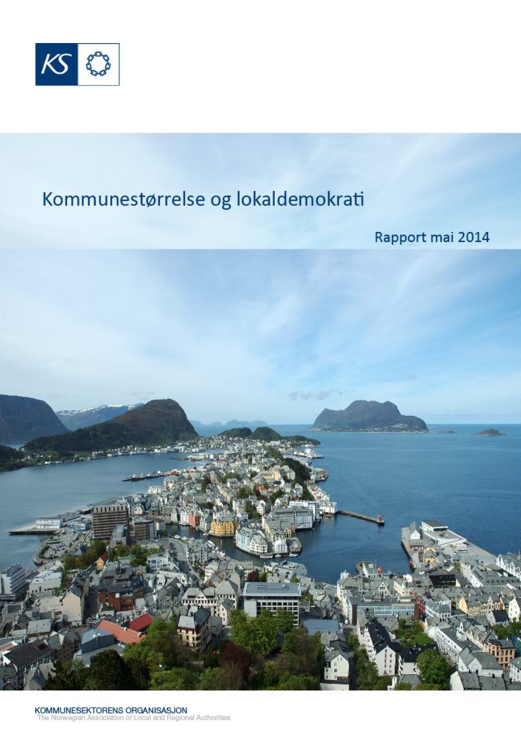
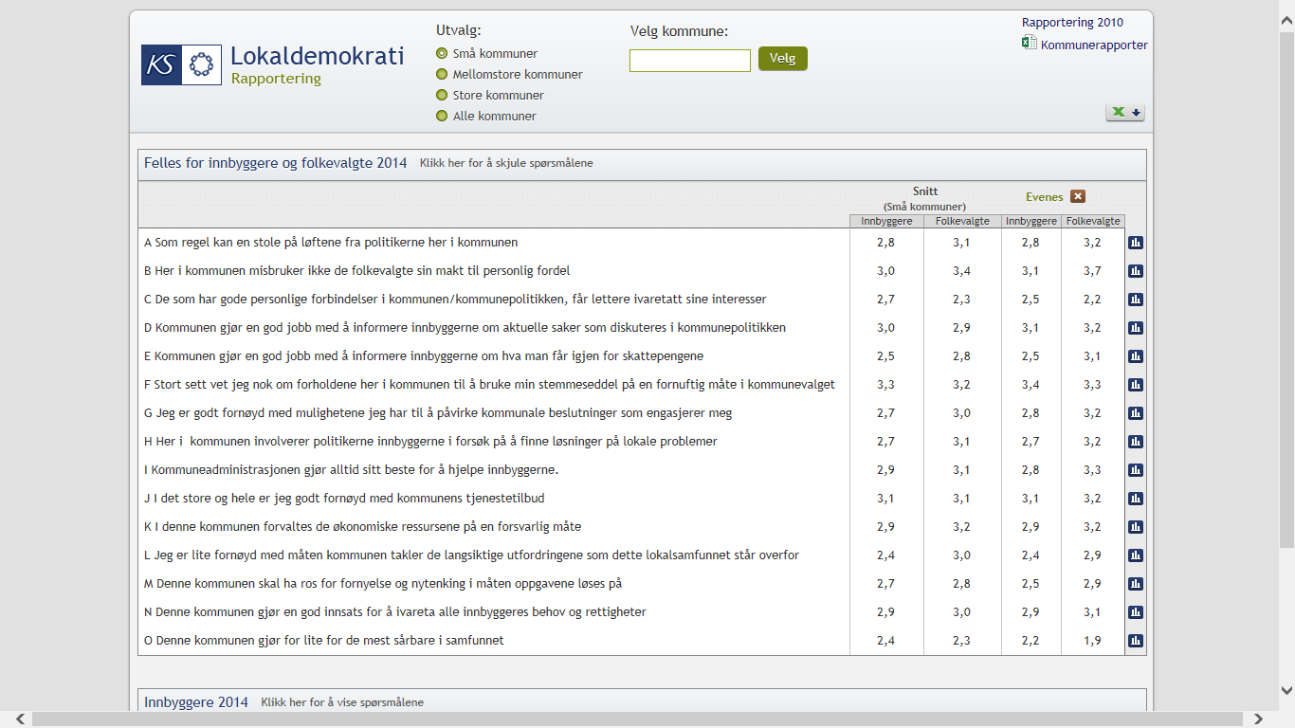
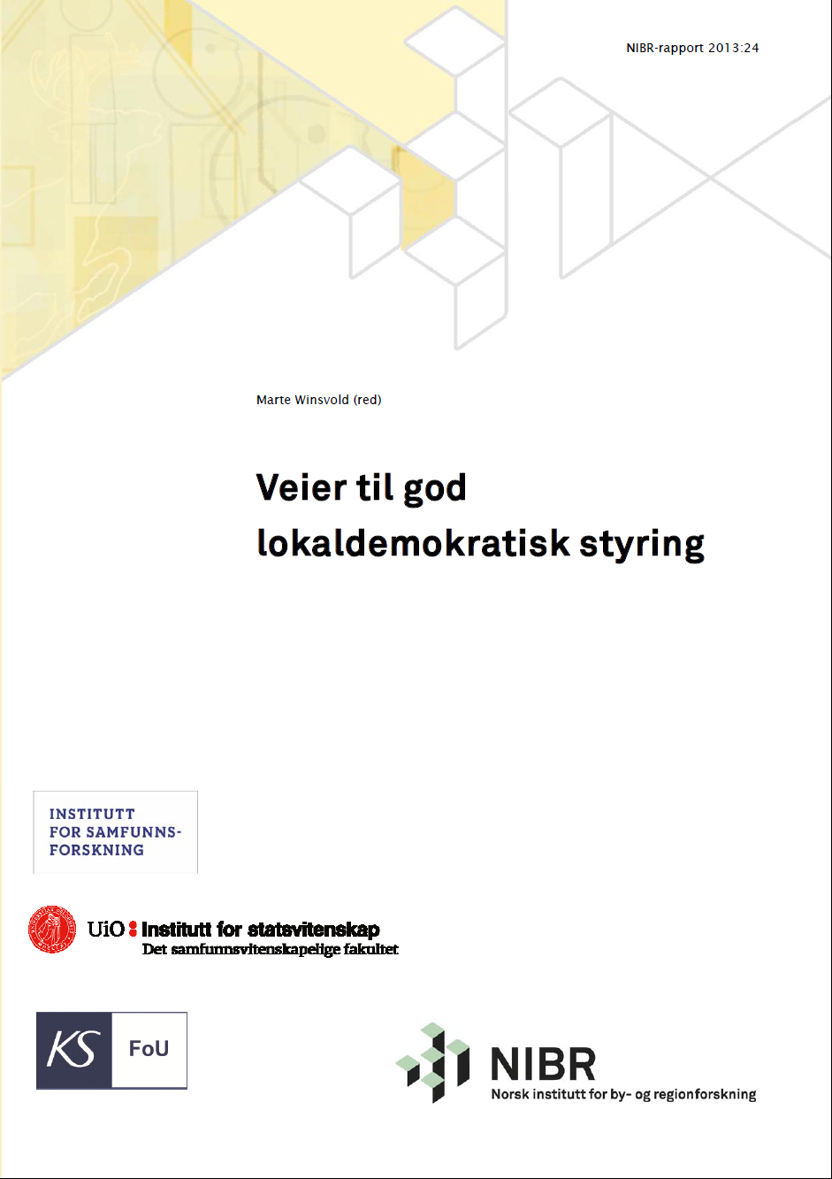
Local democracy
What does size mean for local democracy?
How good is local democracy in one’s own municipality – and how does it compare with others?
How does one succeed in good local democratic management?
How to involve citizens in the decision-making process – e.g. close-up democracy schemes?
Collaboration, networks, owner-management?
Elected representative programme

Slide 23
Employer policy and development network

Slide 24
Finance
Model for calculating changes in the income system and reform funds
Model for comparing municipalities’ differing priorities in welfare provision

