Slide 1
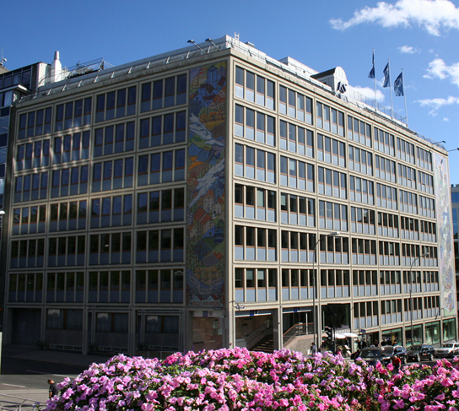
The Norwegian Association for Local and Regional
Authorities –KS
Gunn-Marit Helgesen, President, KS
23 April 2015

Slide 2
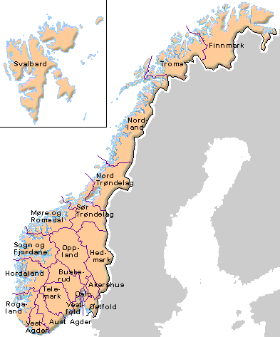
What does KS do ?
428 municipalities
19 counties
500 municipal enterprises
495 000 employees
11 500 councillors
350 billion NOK
KS providing high quality services to 5 million inhabitants from cradle to grave.
Kartgrunnlag Copyright © Statens kartverk,
Norsk Eiendomsinf. og Asplan Viak Internet AS

Slide 3
NATIONAL CONGRESS OF MUNCIPALITIES AND COUNTIES
NATIONAL COUNCIL
NATIONAL COMGRESS OF MUNICIPAL ENTERPRISES
EXECUTIVE BOARD
EXECUTIVE BOARD OF MUNICIPAL ENTERPRISES
COMMITTEE OF CEO
EXECUTIVE COMMITTEE

Slide 4
KS’ most important tasks
Consultations with the National Government on framework conditions for municipal sector
Central collective bargaining
Advisory and consultative body on legal, economic and administrative issues
Research and development, documentation
Development and training of councillors and employees.
10 000 participated in 2014
Organisational development of local democracy

